Slide 1
Recursion

Slide 2
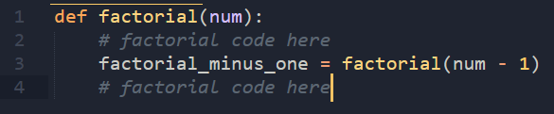
What is a Recursive Function?
By definition, a recursive function is one that calls itself
Can be thought of as taking a big problem and reducing it to smaller chunks
When you cannot reduce anymore, then you combine the solutions
When you can’t combine anymore, it’s often called a base case

Slide 3
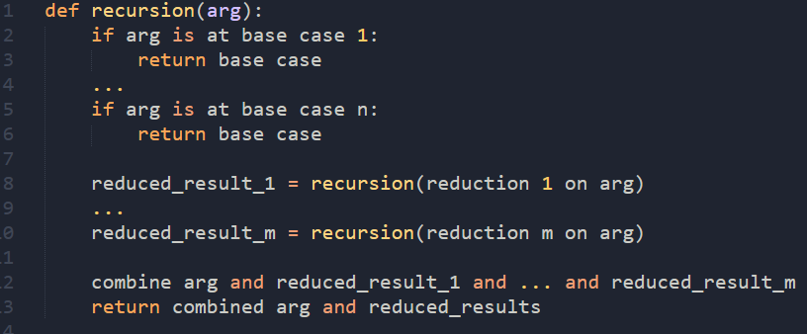
Template for a Recursive Function
Check for base cases first
Then, reduce the problem as many times as you can
Combine all of the reduced results with your arg
Return combined results
Note: usually only 1 base case and only 1 reduction/ combination

Slide 4
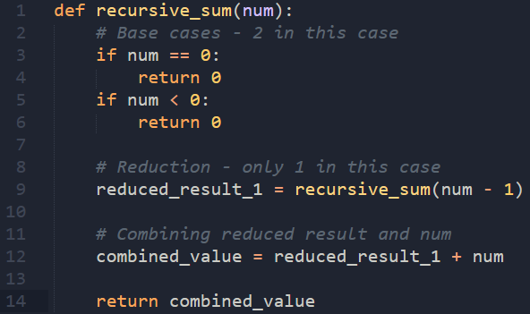
Live Coding: Recursive Sum Function

Slide 5
Recursive sum walkthrough
recursive_sum(5) => 0 + 1 + 2 + 3 + 4 + 5
recursive_sum(4) + 5 => 10 + 5; return 15
recursive_sum(4) => 0 + 1 + 2 + 3 + 4
recursive_sum(3) + 4 => 6 + 4; return 10
recursive_sum(3) => 0 + 1 + 2 + 3
recursive_sum(2) + 3 => 3 + 3; return 6
recursive_sum(2) => 0 + 1 + 2
recursive_sum(1) + 2 => 1 + 2; return 3
recursive_sum(1) => 0 + 1
recursive_sum(0) + 1 => 0 + 1; return 1
recursive_sum(0) => 0
Problem is at its simplest; return base case (0)

Slide 6
Large Group Project 1:
Factorial

Slide 7
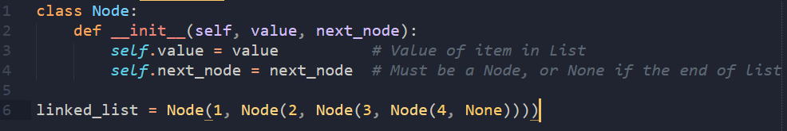
Recursive Data Structures
By definition, a recursive data structure is one that uses itself in its member variables
Usually, can be thought of as “pointing to” another version of itself
Linked lists, trees, and graphs can all be implemented using a recursive data structure
None typically indicates the end of the data structure, if needed

Slide 8
Recursive Data Structure (cont.)
1
2
3
4
None

Slide 9
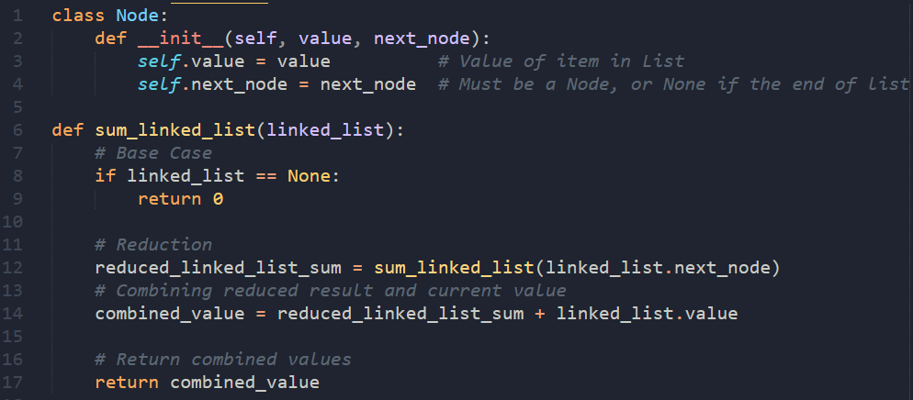
Live Coding: Summing a Linked List

Slide 10
Recursive Functions and Data Structures
Recursive functions work really well with recursive data structures
Recursive data structures by their own definition can easily be split up into smaller data structures
In our linked list example, a large linked list was split into many smaller linked lists until you got to the smallest linked list possible: an empty list represented by None
Big, hard to process linked list
1
2
3
4
None
Smaller, slightly easier to process linked list

Slide 11
Large Group Project 2:
Find max in Tree

Slide 12
Pair Project:
Family Tree

